Slide 1






EDPT1009
ROBOTICS
Presentation

Slide 2

Our Team
Nada Ehab
Ibrahim Amr
Martin Morcos
Abdelrahman Khaled
Mohamed Osama
Mohand Mohamed

Slide 3
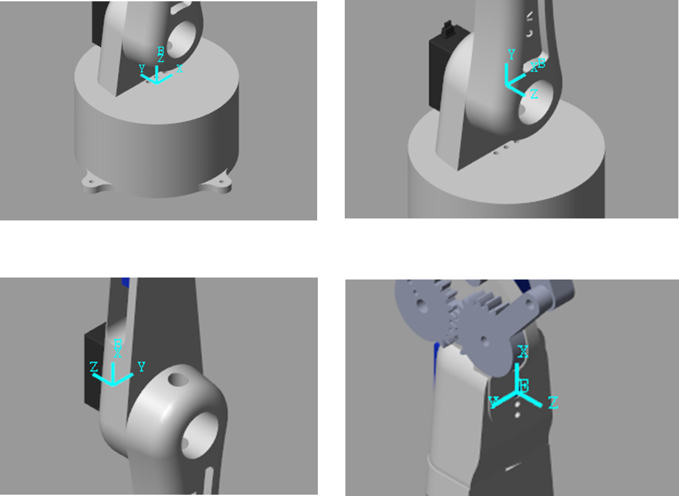
DH Parameters Chosen
•Frames assigned from base to end‑effector

Slide 4
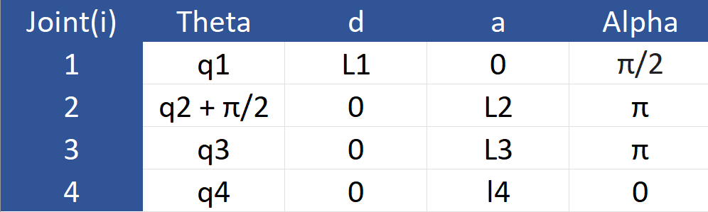
DH Parameters Chosen
•Standard Denavit–Hartenberg convention used
•Parameters define link lengths and joint offsets

Slide 5
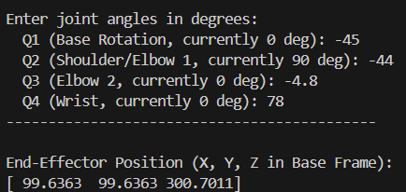
Forward Kinematics Validation
Python

Slide 6
Inverse Kinematics Validation
•Numerical IK solved using Newton–Raphson method
Compared mathematical solution with simulation results
•Small offset due to different EE reference points

Slide 7
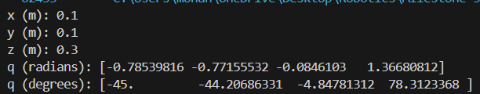
Inverse Kinematics Validation
Python

Slide 8
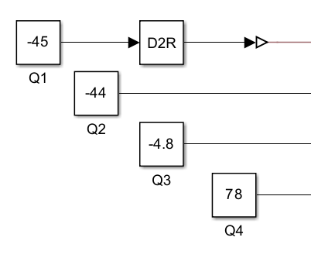
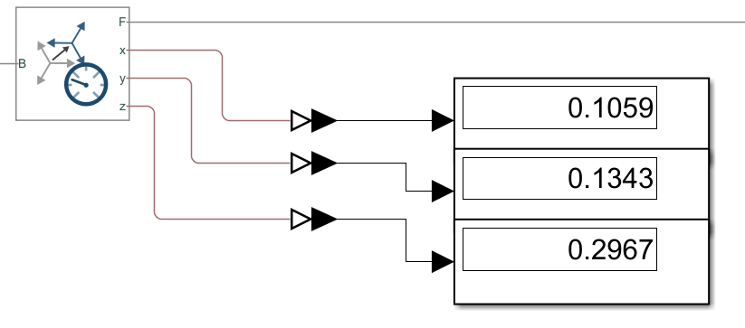
Inverse Kinematics Validation
Matlab

Slide 9
Inverse Kinematics Validation
Gazebo

Slide 10
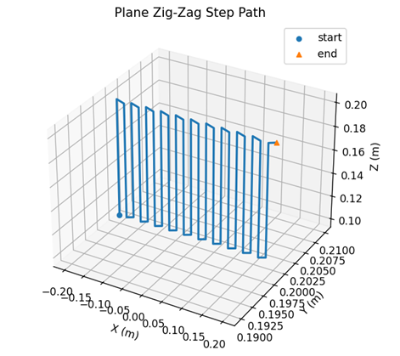
Trajectories in Gazebo & Simscape
•Trajectory 1: Planar surface coverage (wall sanitization)

Slide 11
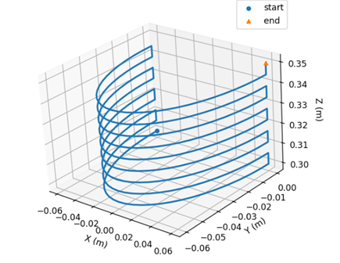
Trajectories in Gazebo & Simscape
•Trajectory 2: Curved motion around robot (barrel interior)

Slide 12
Hardware Trajectory Execution
  Full trajectory successfully executed on real hardware
  Motion matches simulated path within mechanical tolerances

Slide 13
Conclusion
  DH model accurately represents robot geometry
  IK validated mathematically and in simulation
  Trajectories successfully demonstrated virtuall
  Same trajectory applied to hardware

Slide 14

Result Videos

Slide 15
Thank You

